Slide 1
TDD in TypeScript
Test Driven Development
DEV3LSOLUTIONS.COM
Notes:
8 hours – 1 hour lunch break
7 hours = 420 minutes
10-minute break every hour
- Try to break on exercise to catch up anyone

Slide 2
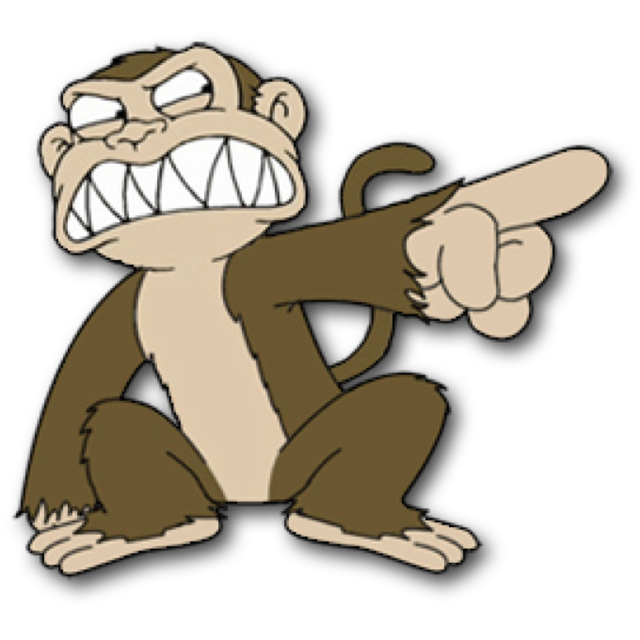

Justin Beall
Justin Beall
15 Years Software Engineering
CSM, A-CSD, CSPO, SA
Favorite language, Python
15 Years Software Engineering
CSM, A-CSD, CSPO, SA
Favorite language, Python
2
Notes:
2m : 2m

Slide 3
INTRODUCTIONS
INTRODUCTIONS
Notes:
18m : 20m
Who are we?
Learning environment, feel free to ask questions.
What is everyone’s familiarity with the stack / software development.
Breakout rooms
Regular breaks – shoot for 10 till the hour, leaves room for questions and catch up as necessary
Who are you?
What do you do?
What do you want to learn in class?
Tell me about your automation experience

Slide 4
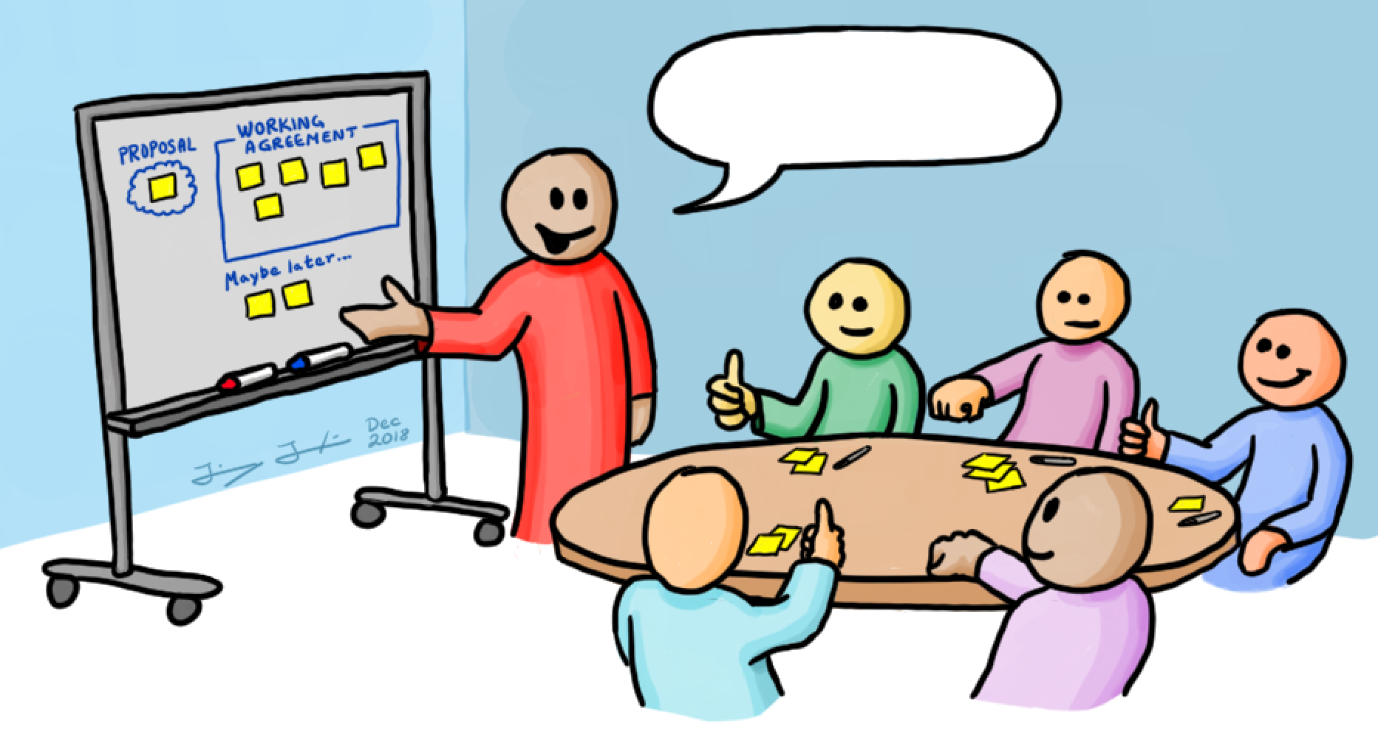

Course Objectives
Working Agreements
Understanding the Benefits of TDD
Learning Good Testing Practices
What code smells to look for
Level up your knowledge!
Start / End Time
- Respect your peers; don’t be late
Be Present
- Participate
Own your learning
- Speak up if you don’t understand something
You aren’t done until the (virtual) person next to you is done
Code (1) Make it work; (2) Make it better
Notes:
5m : 25m

Slide 5

Course Objectives
Summarize the value of TDD
Use TDD to solve Katas
Integrate TDD Into Daily Work
Recognize the benefit of writing clean, maintainable code
Notes:
5m : 30m

Slide 6
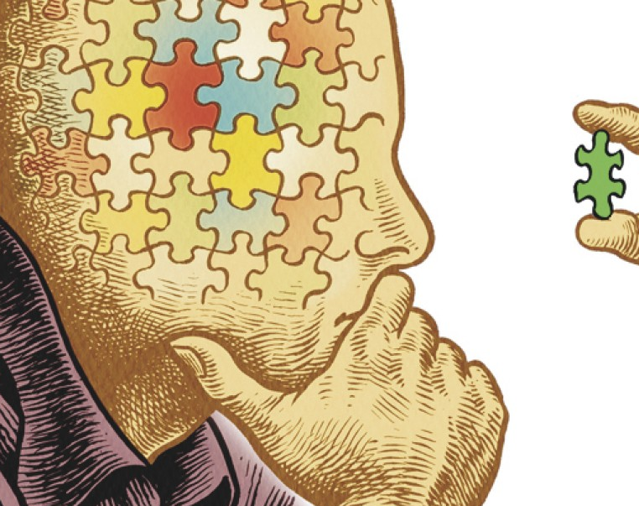
Why Are We Here?
Notes:
5m : 35m
How is testing performed currently?
Why Test First, not Test After?
We are here to learn to write tests and use those tests to drive our design.
-- war stories
Has anyone been on a project using TDD?
Has anyone worked on a legacy project?
Touch one thing over here, and something breaks over there

Slide 7
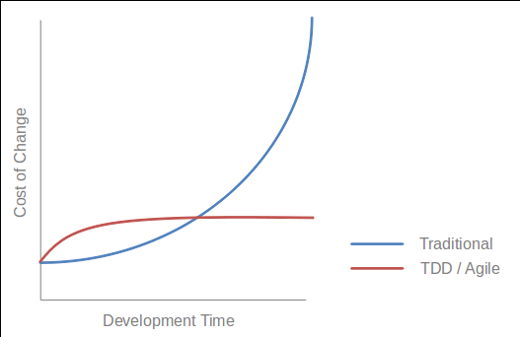
What is Test Driven Development?
A Programming Discipline
High-feedback incremental coding technique
Write tests as specs, prior to code
Core of the cycle:
Write a test
Write the code to make the test pass
Notes:
10m : 35m
--- What
Test-driven development (TDD) is a software development process that relies on the repetition of a very short development cycle:
Requirements are turned into very specific test cases, then the software is improved to pass the new tests, only. This is at the Unit Level (Classes and Methods in Code).
This is opposed to software development that allows software to be added that is not proven to meet requirements.
--- Discipline
TDD is a discipline, disciplines are arbitrary or at least they have arbitrary components to them. Disciplines have arbitrary behaviors that are driven by some substantial motives.
For example, how do doctors wash their hands before surgery? Do they just go in there and wash hands like normal people do? no, there is discipline something like this. There is special brush, soap and they turn on the water and it is ten strokes across the side of fingers. You understand why they do that, there is motive behind that, but is ten the right number? could it be twelve or eight, it is arbitrary. It is just a guess, ten probably enough.
The discipline is motivated by something real. The discipline of TDD works like this, There are three rules.
--- Double Entry Bookkeeping
We produce documents filled with code - arcane symbols in strange shapes and structure, no one else can read them only programmers.
What other field, employment has problem like that? Where they construct the document that are arcane and full of symbols and every symbols have to be correct. Accountants. How do accountants make sure that their documents are correct? They have a discipline that was invented 500 years ago, called Double-entry bookkeeping. They enter everything twice. TDD is Double-entry bookkeeper, is exactly the same discipline done for precisely same reason, we say everything twice, once on test side, once on production code side, they follow execution, complimentary execution pathways they wind up with zero, zero test failed. Same discipline, Same reason, Same outcome.

Slide 8
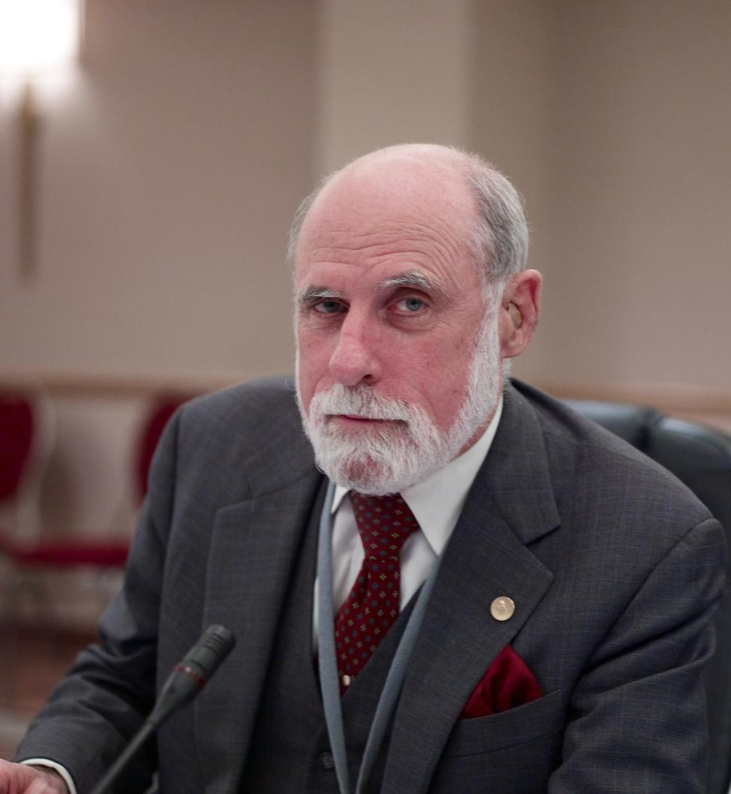
Test First is NOT new
“A software system can best be designed if the testing is interlaced with the designing instead of being used after the design.” - Professor Alan J. Perlis
NATO SOFTWARE ENGINEERING CONFERENCE 1968
Notes:
5m : 40m
An American computer scientist and professor at Purdue University, Carnegie Mellon University and Yale University. He is best known for his pioneering work in programming languages and was the first recipient of the Turing Award.
If thought leaders believed this back in the late 60’s, why is it not common place today?

Slide 9
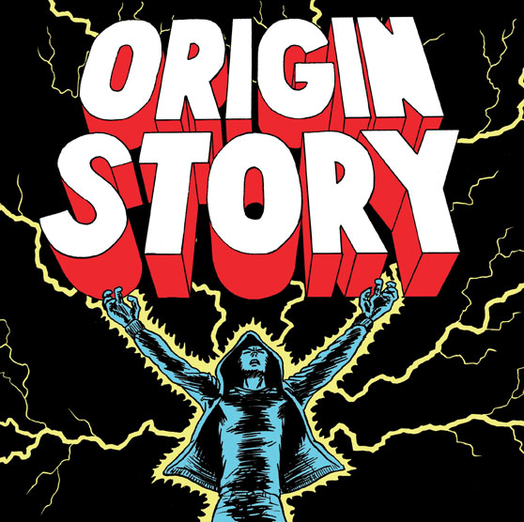
Kent Beck’s "rediscovering" TDD
“The original description of TDD was in an ancient book about programming. It said you take the input tape, manually type in the output tape you expect, then program until the actual output tape matches the expected output. After I'd written the first xUnit framework in Smalltalk I remembered reading this and tried it out. That was the origin of TDD for me. When describing TDD to older programmers, I often hear, "Of course. How else could you program?" Therefore, I refer to my role as "rediscovering" TDD.”
Notes:
5m : 45m
American software engineer Kent Beck, who is credited with having developed or "rediscovered" the technique, stated in 2003 that TDD encourages simple designs and inspires confidence.
The SUnit (later to be known as xUnit) was designed by Kent Beck in 1998
---
Automated unit testing nothing new
But writing the tests incrementally and first is
Automation originally devised by Ward Cunningham
Honed by Kent Beck in Smalltalk
Incorporated as a practice of Extreme Programming (XP)

Slide 10
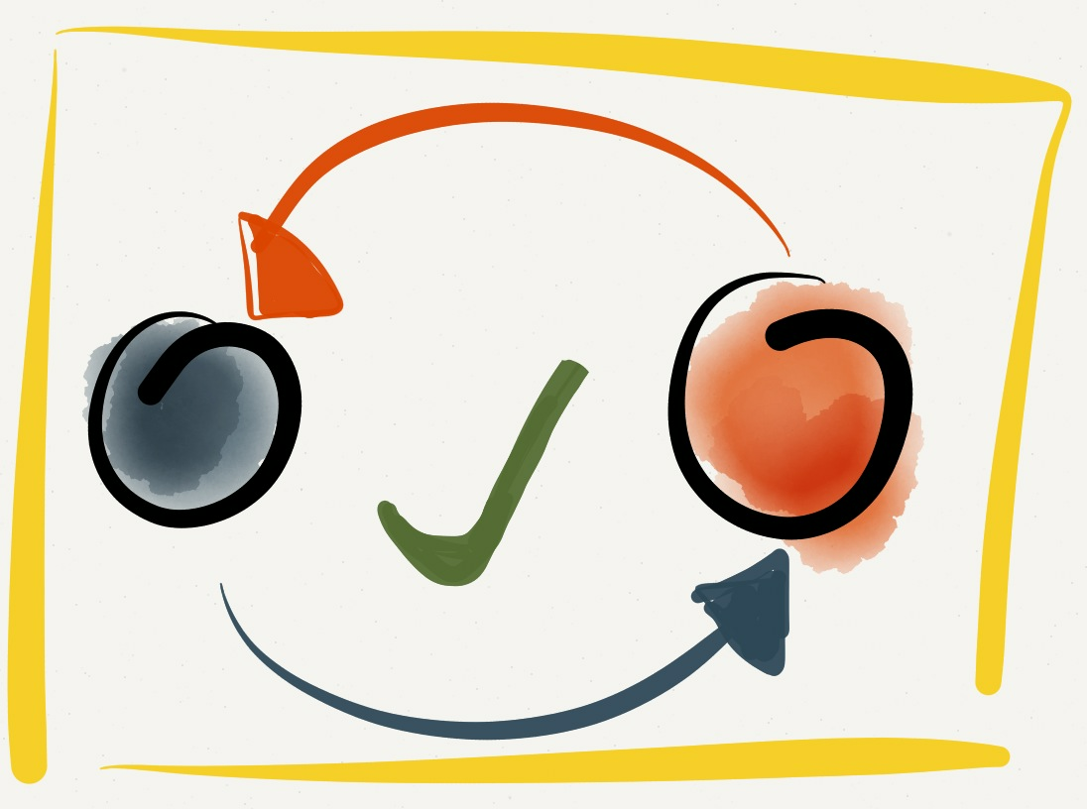
The Three Laws of TDD
1. You are not allowed to write any production code unless it is to make a failing unit test pass.
2. You are not allowed to write any more of a unit test than is sufficient to fail; and compilation failures are failures.
3. You are not allowed to write any more production code than is sufficient to pass the one failing unit test.
Notes:
10m : 55m
Test Driven Development as described by Uncle Bob Martin
Break down each one of the laws and discuss what it means. “Following these laws perfectly doesn’t always make sense.
Sometimes you’ll write a larger test.
Sometimes you’ll write extra production code.
Sometimes you’ll write tests after you’ve written the code to make them pass.
Sometimes it’ll take more than two minutes to go around the loop.
The goal isn’t perfect adherence to the laws—it’s to decrease the interval between writing tests and production code to a matter of minutes. “ - Uncle Bob

Slide 11
The Three Laws of TDD
1. Only write production code to make a failing unit test pass
2. Only write enough of a unit test to make the test fail
3. Only write enough implementation to make failing test pass
Notes:
0m : 55m
Rules simplified As a discipline, what do we get by following these laws?

Slide 12

Doing TDD
A skill which you must learn and practice - Expect it to be initially awkward
Expect some level of addiction - Fast feedback & Green Tests = more dopamine!
Notes:
5m : 60m
Like any new skill – initially writing tests can be awkward Typically used to diving right into problem solving through implementation Writing a test first forces you to think about the expected outcome of a VERY small step
As you get into a rhythm, every time you make a new test pass – it starts building up excitement

Slide 13

BREAK 10:15
Notes:
10m : 70m

Slide 14
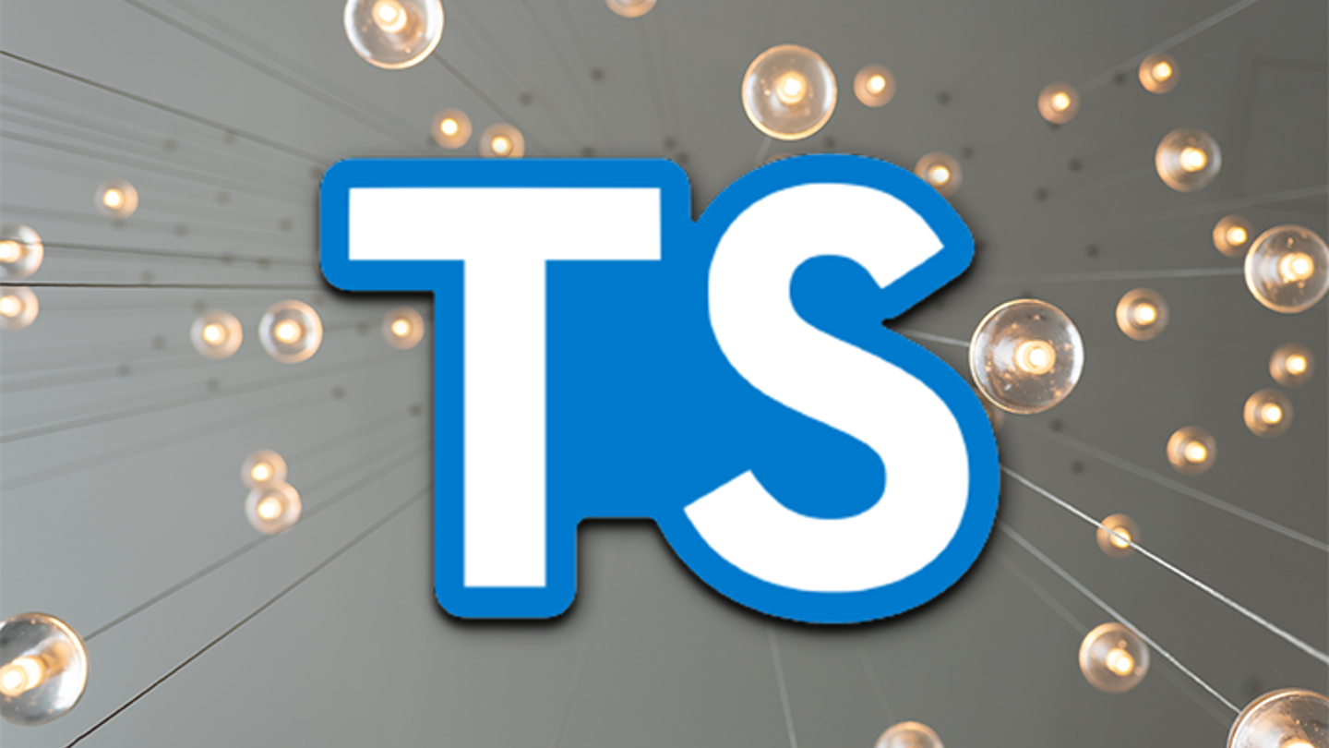
TypeScript Overview
00_typescript
Notes:
15m : 85m
Make sure everyone has computer configured and runnable.
If we run into problems, pair up and resolve the problems at lunch time.
Review TypeScript.
Walk before you run.
How can we get started?
Make sure everyone can run TypeScript

Slide 15
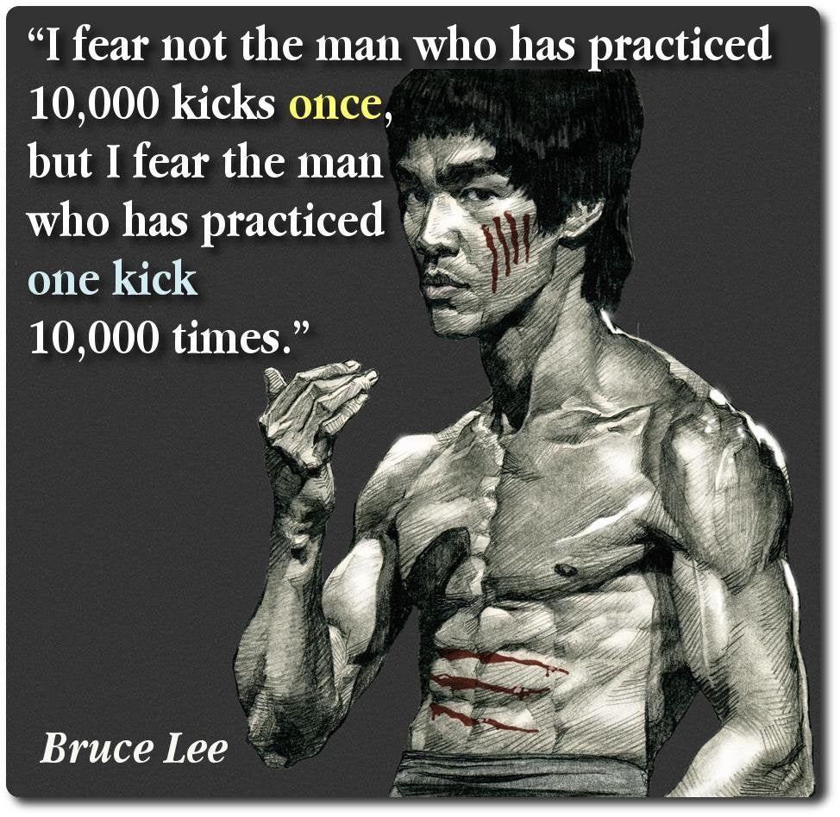
Kata
Notes:
10m : 85m
Kata is a Japanese word meaning "form".
It refers to a detailed choreographed pattern of martial arts movements made to be practised alone.
It can also be reviewed within groups and in unison when training.
It is practised in Japanese martial arts as a way to memorize and perfect the movements being executed.
Does anyone here ever “practice” programming?
- What other professions involve daily practice?
Is anyone aware of any know any programming practice sites?
- “koans” : https://github.com/paytonrules/typescript.koans - “Coding Dojo” : https://codingdojo.org/
- “Hacker Rank” : https://www.hackerrank.com/ - “Exercism.io” : https://exercism.org/

Slide 16
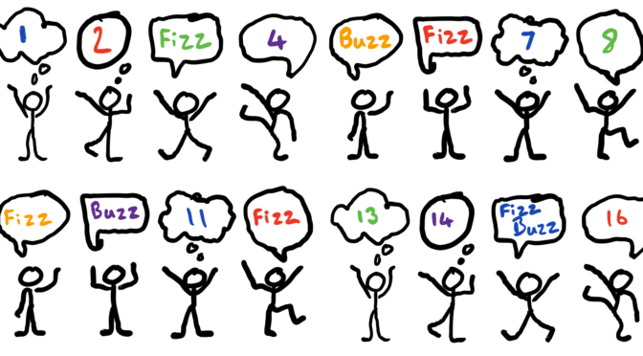
Kata: Fizz Buzz
01_fizz_buzz
Notes:
30m : 115m
http://codingdojo.org/kata/FizzBuzz
Has anyone here ever done FizzBuzz?
Has anyone here ever done FizzBuzz using TDD??
Discuss problem – give hint about the modulo operator “%”

Slide 17

Review
Notes:
10m : 125m
What went well?
What didn’t go well?
Look at some solutions
What if we wanted to use classes?
What if we wanted to use only a function?
What if we didn’t want to use any for loops?

Slide 18

BREAK 1:00
Notes:
10m : 135m

Slide 19
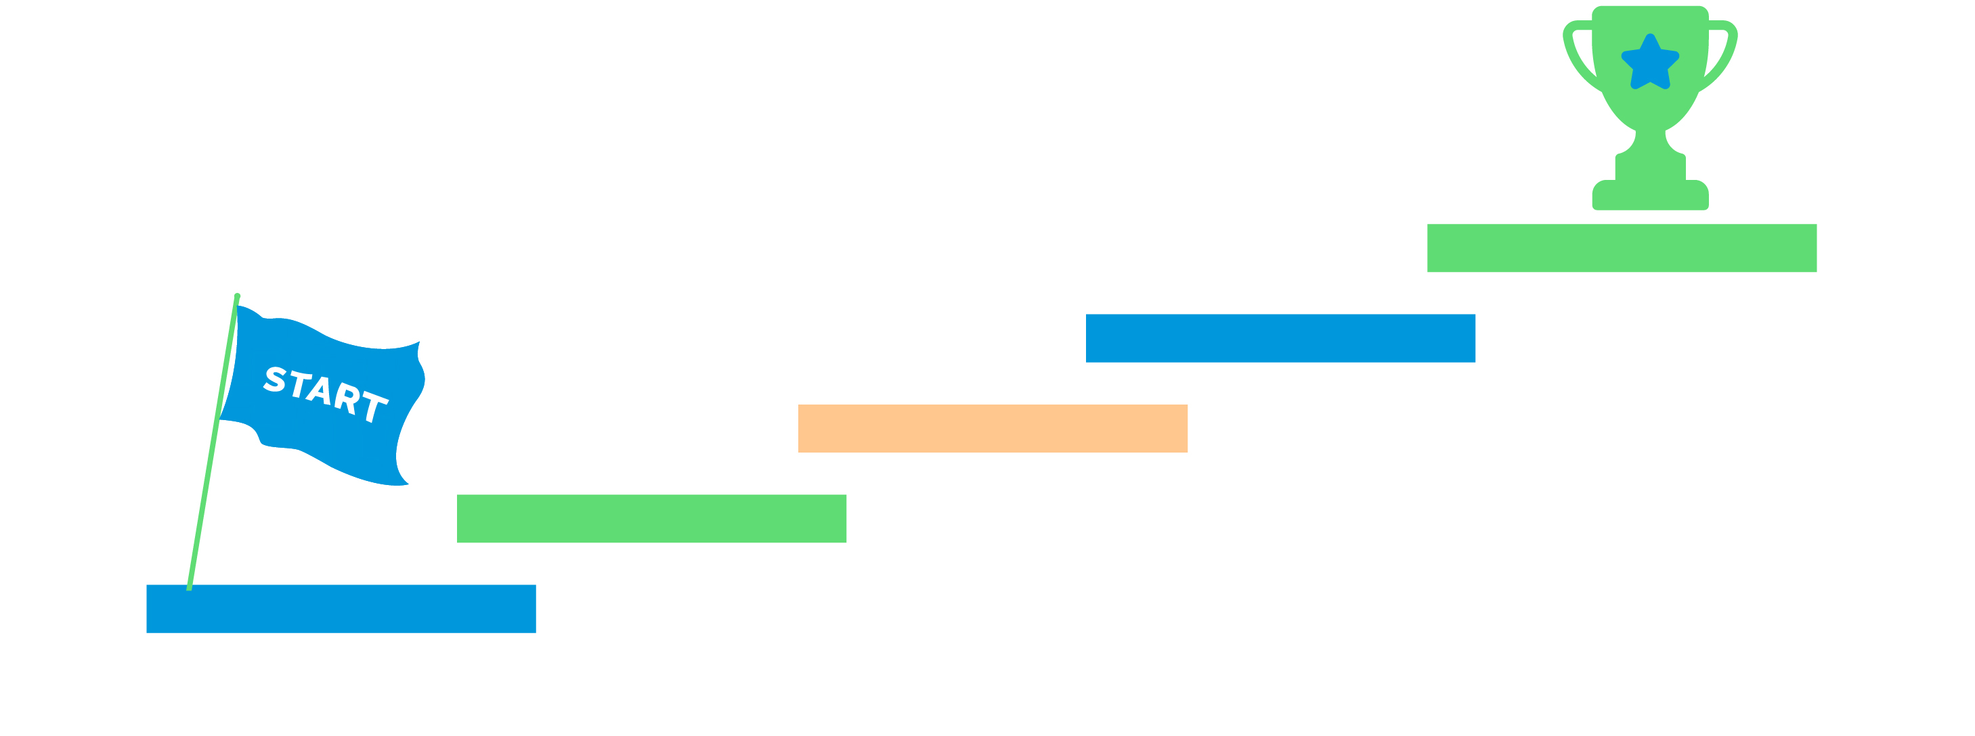
TDD Steps
- Write test (red) - Write implementation (green)
- Write test (red) - Write implementation (green)
…
Notes:
5m : 140m
If it is this simple, then why is it so hard to do?
Why is test first different than test after?
- Which one drives the design?
Where do we begin?

Slide 20
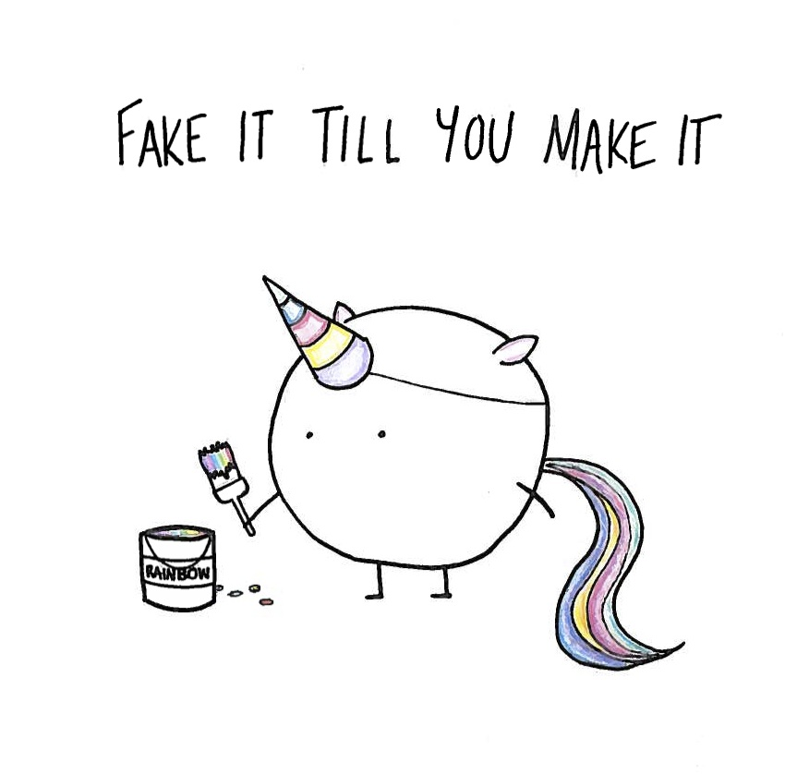
Notes:
5m : 145m
Fake it 'til you make it says to write the simplest possible thing to pass your current tests. Frequently, when you've written a single test case for a new feature, that simplest possible thing is to return a constant. When something that simple satisfies your tests, it's because you don't (yet) have enough tests. So write another test. Now the feature you're developing needs some logic to it. Maybe this time the simplest possible thing is to write very basic if-else logic to handle your two test cases. You know you're faking it, so you know you're not done. When it becomes simpler to write the actual code to solve your problem than to extend your fake to cover yet another test case - that's what you do. And you've got enough test cases to make sure you're writing it correctly.
If you are not used to this, it will drive you insane at first… you know the solution, will require <x> - so why not just implement that?

Slide 21
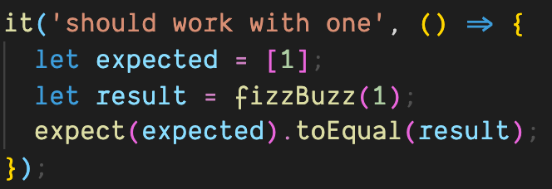
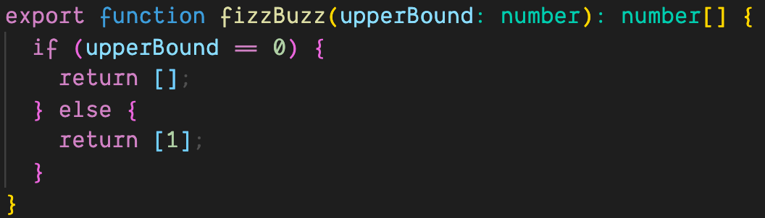
Notes:
5m : 150m
When we look at this, we obviously know this is not the desired solution – but as far as our tests are concerned, this is all the matters
What is the value in this? “Earning Complexity”
Regardless of the implementation, “it should work with one” will ALWAYS pass – having this safety net allows us to expand into much more complicated business object
Where else do we return stubbed results? Front end developing against a non-existent API – we know the shape, we know the expected results, but until complete we just return a static result

Slide 22
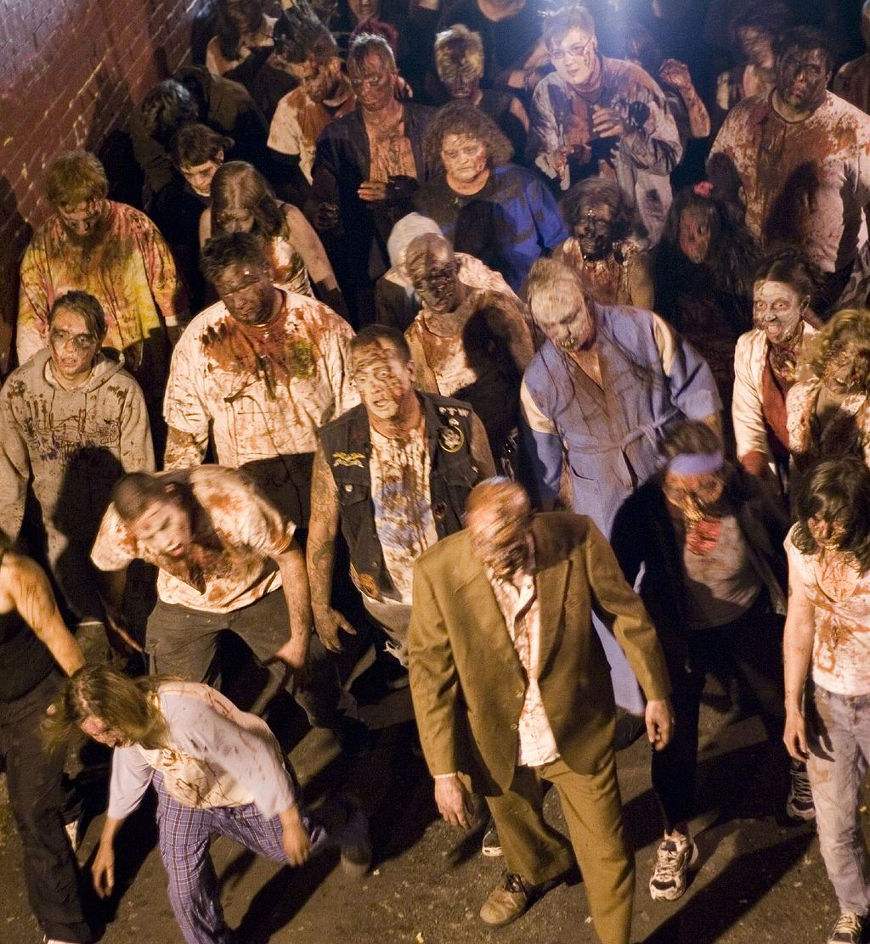
TDD Guided by ZOMBIES
Z – Zero O – One M – Many (or More complex) B – Boundary Behaviors I – Interface definition E – Exercise Exceptional behavior S – Simple Scenarios, Simple Solutions
https://blog.wingman-sw.com/tdd-guided-by-zombies
Notes:
15m : 165m
Have you had a hard time figuring out where to start with Test-Driven Development.
People new to TDD often struggle with what test to write. It’s hard to know where to start or what test to write next. It’s hard to know when you are done, and it’s scary to think you will leave some incomplete code behind
When test-driving, guided by ZOMBIES, the first test Scenarios are for Simple post-conditions of a just created object. These are the Zero cases. While defining the Zero cases, take care to design the Interface and capture the Boundary Behaviors in your test Scenarios. Keep it Simple, both Solutions and Scenarios. You’ll find that hard. Once progress is made on the Zero cases, move to the next special Boundary case, testing the Behavior desired when transitioning from Zero to One. To do so there are likely other Interfaces to define and use in new test Scenarios. Once the Boundary Behaviors between Zero and One (and possibly back to Zero from One) have been captured in tests, move on to start to generalize your design now dealing with More complex Scenarios and Many items being managed. Often there are new Boundary conditions to be concerned with. Finally review your work and make sure you consider and Exercise the Exceptional things that might happen
Go through each step, in regards to Fizz Buzz
http://blog.wingman-sw.com/tdd-guided-by-zombies

Slide 23
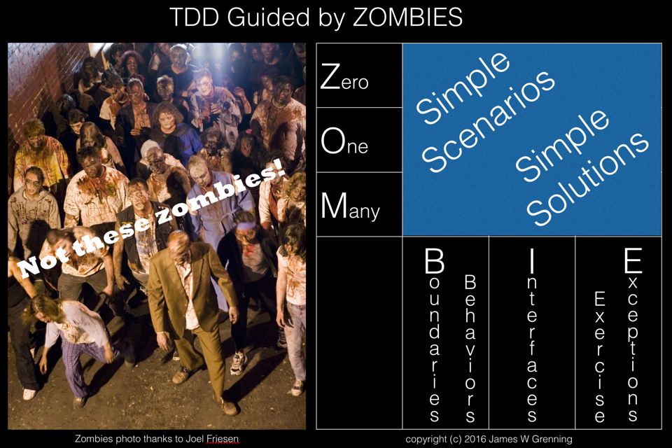
02_fizz_buzz_zombies
Notes:
30m : 195m
Implement Fizz Buzz using ZOMBIES - class follows along, make space for questions

Slide 24

Review
Notes:
15m : 210m
Was that different than how anyone else implemented their Fizz Buzz solution?

Slide 25

BREAK 2:20
Notes:
10m : 220m (Lunch)

Slide 26

TDD Outcomes
Creates testable code by definition - Obvious but significant! - Writing tests after code built usually much harder
Contributes to minimizing defects
Notes:
10m : 230m
What would happen if we worked this way in production?
Has anyone been in a code base that was “difficult to test”?
Why would something be difficult to test?
How would this help us “minimize“ defects?
Just because we wrote a unit test, does not mean the implementation is correct
In the scenario where we touch one thing, and other things break – how would working this way help?

Slide 27
TDD Outcomes
TDD promotes better design - Teaches you how to design isolated pieces
Creates comprehensive developer-level documentation
Development pacing - Constant positive feedback
Tests are living specifications
Notes:
10m : 240m
How does TDD promote better design?
Tests are code examples! Have you ever looked at a piece of code, and wonder how to create a new instance? Or, what the result of a function would be?
How many times has anyone here ever been 100% complete, but have testing left to do? - Is this really “done”?
I thought we didn’t do specifications in agile?

Slide 28
SOLID: Principles of Object-Oriented Design
S - Single-responsibility Principle O - Open-closed Principle L - Liskov Substitution Principle I - Interface Segregation Principle D - Dependency Inversion Principle
Notes:
5m : 245m
Has anyone here heard of SOLID before?
Why would this be important?

Slide 29
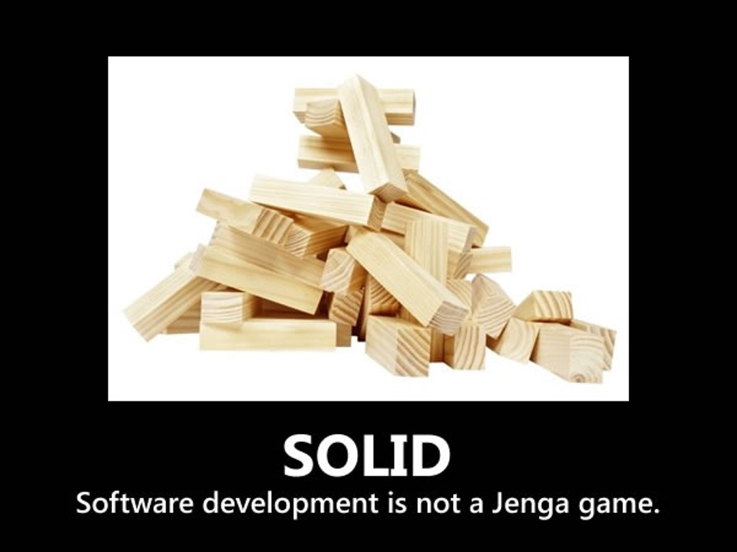
Notes:
5m : 245m
That’s a pretty sweet swiss army knife…

Slide 30
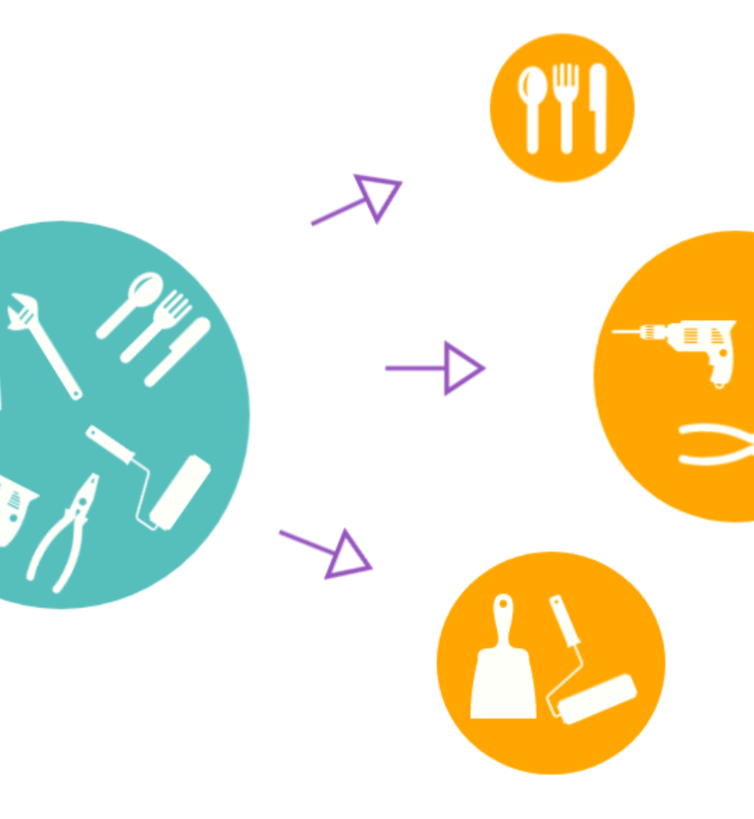
Single-responsibility Principle
A class should have one and only one reason to change, meaning that a class should have only one job.
Notes:
5m : 250m
Single-responsibility Principle (SRP) states - A class should have one and only one reason to change, meaning that a class should have only one job
- How large should a function be? How about a class? What is the definition of “one”
UNIX philosophy
- Many tools do one thing, and only one thing – very well

Slide 31
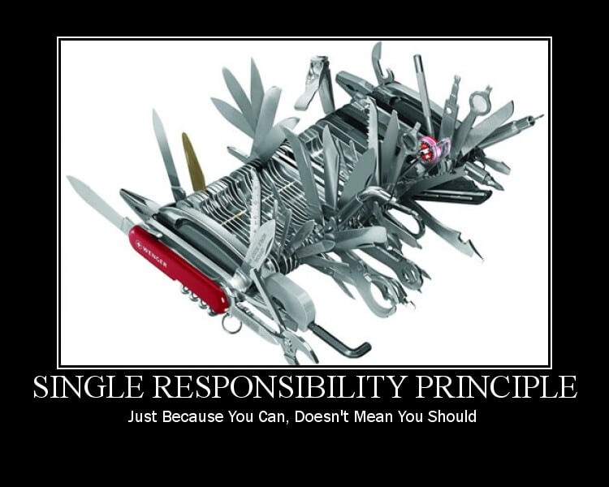
Notes:
5m : 250m
That’s a pretty sweet swiss army knife…

Slide 32
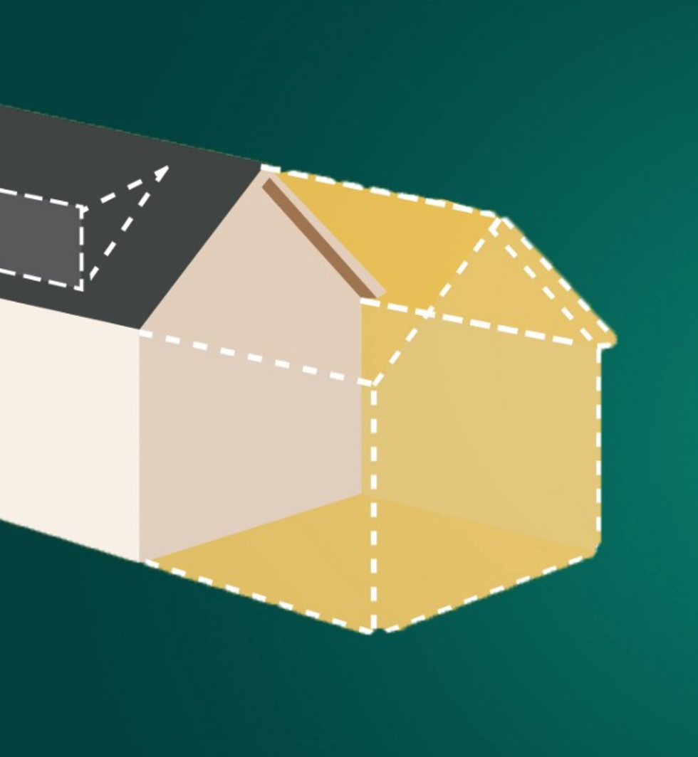
Open-Closed Principle
Objects or entities should be open for extension but closed for modification
32
Notes:
5m : 255m
Doesn’t it feel “rude” to touch a working piece of code?
This means that a class should be extendable without modifying the class itself.

Slide 33
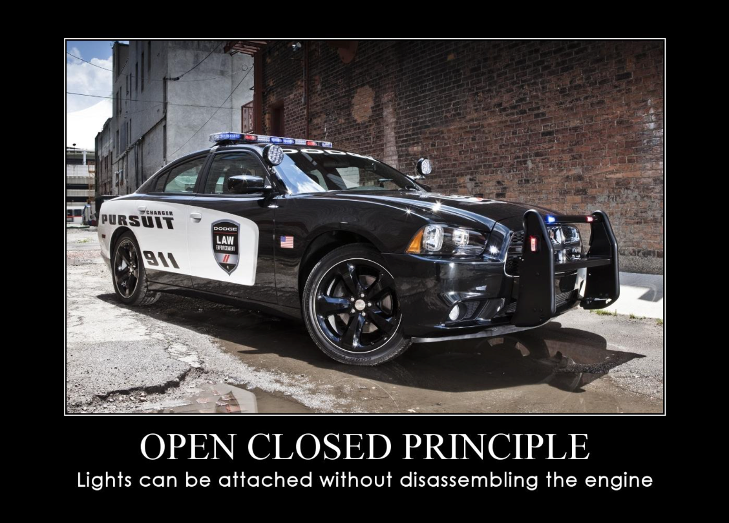
Notes:
5m : 255m
What if mechanics didn’t follow open closed?

Slide 34
Liskov Substitution Principle
Objects of a superclass shall be replaceable with objects of its subclasses without breaking the application
Notes:
5m : 260m
If it looks like a duck, and quacks like a duck, then it is a duck
Why would we define a variable as interface instead of a concrete?
List<String> ducks = new ArrayList<Ducks>();

Slide 35
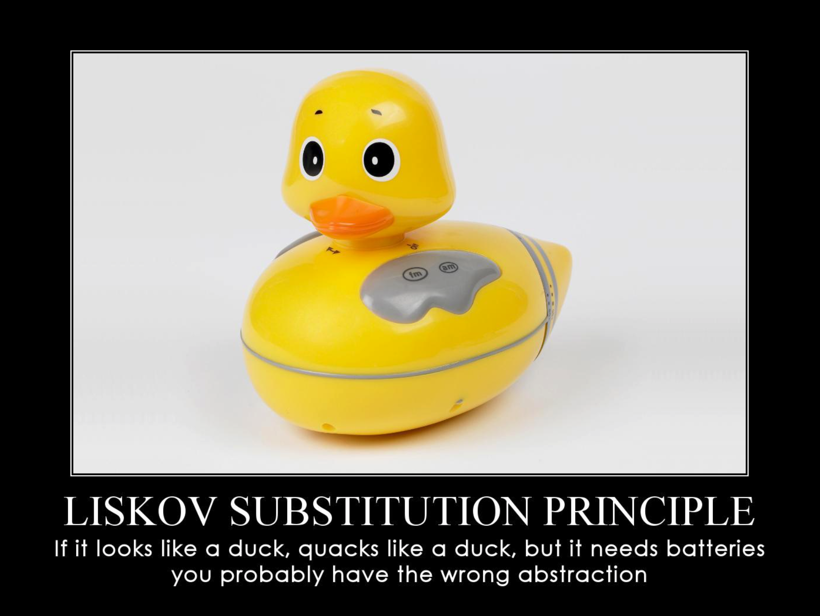
Notes:
5m : 260m
Is this a Duck?

Slide 36
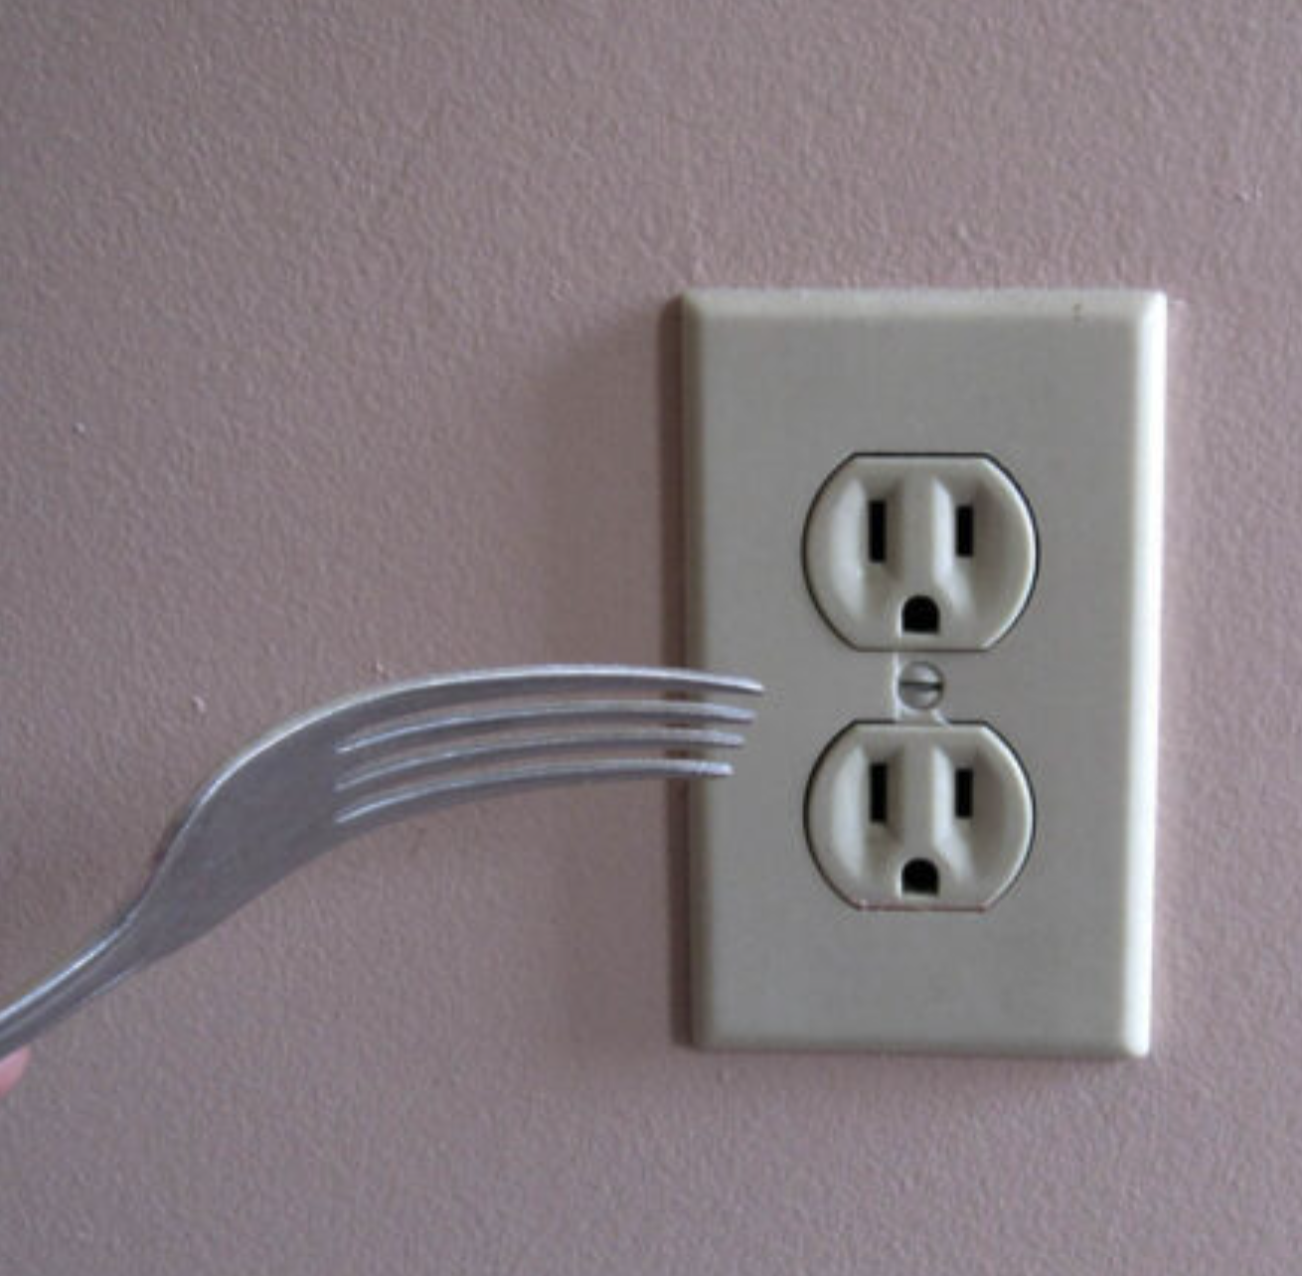
Interface Segregation Principle
A client should never be forced to implement an interface that it doesn’t use, or clients shouldn’t be forced to depend on methods they do not use.
Notes:
5m : 265m
Why would we want smaller specialized interfaces?
Has anyone ever been in a project where there was just one interface for everything?
Class littered with stubs of not implemented exceptions

Slide 37
Notes:
5m : 265m
How useful is this really?

Slide 38
Dependency Inversion Principle
Entities must depend on abstractions, not on concretions. It states that the high-level module must not depend on the low-level module, but they should depend on abstractions
Notes:
5m : 265m
What does inverting our dependency meany?
How do you test a class which has acess to some global context?
- Why not just pass that into the class itself in the constructor
This is the ROOT OF ALL EVIL in legacy systems
- Every time you “new” inside of a class, you are FORCING it to depend on that specific implementation

Slide 39
Notes:
5m : 265m
The socket does not depend upon the lamp, the lamp depends upon the socket

Slide 40
DRY Principle
D - Don’t R - Repeat Y - Yourself
Every piece of knowledge must have a single, unambiguous, authoritative representation within a system.
Notes:
5m : 270m
First introduced in the book The Pragmatic Programmer. The principle itself was known and applied before this book came to life; but the Pragmatic Programmer defined it precisely and coined its name.
Why is duplication the root of all evil?
When would you not want to duplicate something?
When would you want to duplicate something?
Opposite of DRY is WET
W - Write
E - Everything
T - Twice

Slide 41

YAGNI Principle
Y - You A - Ain’t G - Gonna N - Need I - It
Notes:
5m : 275m
Yagni is a way to refer to the XP practice of Simple Design
What is the cost of gold plating? What benefit does this give us?

Slide 42
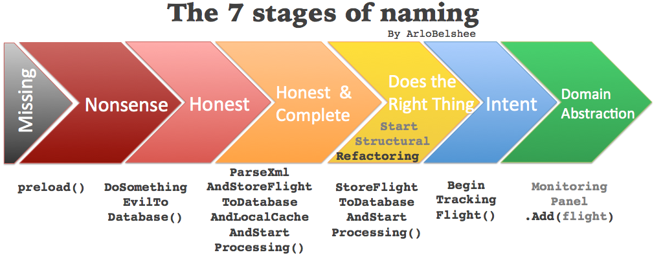
Notes:
5m : 280m
Why are names so important?

Slide 43

BREAK
Notes:
10m : 290m

Slide 44
Kata: Roman Calculator
03_roman_calculator
Notes:
45m : 335m
https://codingdojo.org/kata/RomanCalculator
Problem Description
“As a Roman Bookkeeper I want to add Roman numbers because doing it manually is too tedious.” Given the Roman numerals, (IVXLCDM which mean one, five, ten, fifty, hundred, fivehundred and a thousand respectively), create two numbers and add them. As we are in Ancient Rome there is no such thing as decimals or int, we need to do this with the strings. An example would be “XIV” + “LX” = “LXXIV”
There are some rules to a Roman number:
Numerals can be concatenated to form a larger numeral (“XX” + “II” = “XXII”)
If a lesser numeral is put before a bigger it means subtraction of the lesser from the bigger (“IV” means four, “CM” means ninehundred)
If the numeral is I, X or C you can’t have more than three (“II” + “II” = “IV”)
If the numeral is V, L or D you can’t have more than one (“D” + “D” = “M”)

Slide 45

Review
45
Notes:
15m : 350m
Review class solutions
A little bit more complicated than Fizz Buzz…
Did unit tests help you out in any way?
What if another character number type was added?
Would you be confident you could update your solution to accommodate?

Slide 46

Day 1 - Wrap Up
Notes:
Retrospective / Reflect (if time)

